Slide 1




CLOUD DEPLOYMENT MODELS
Kaushik Yadav
Btech (IBM)
2nd Year

Slide 2




UNDERSTANDING CLOUD DEPLOYMENT MODELS
  Cloud deployment models describe how cloud services are made available to users.
  They differ in ownership, security level, cost, and accessibility.
  Choosing the right model helps organizations balance data security, scalability, and budget.

Slide 3

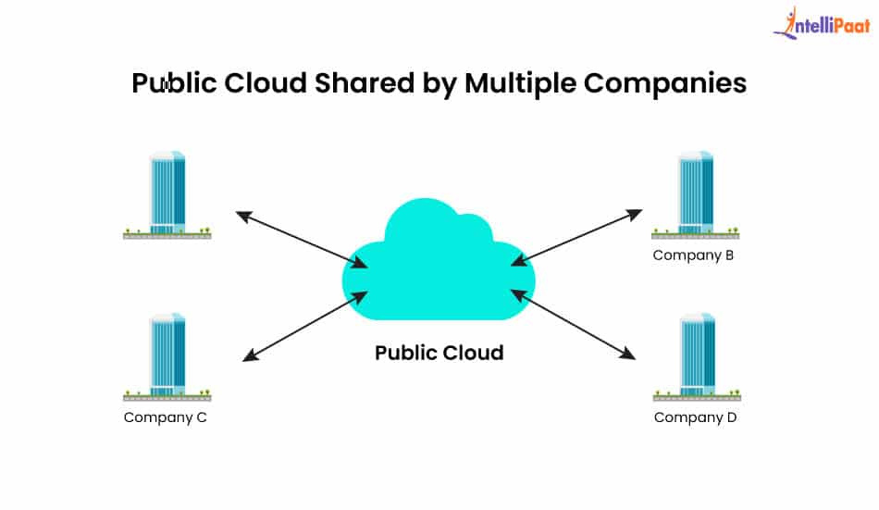
PUBLIC CLOUD – OPEN, SCALABLE & COST-EFFECTIVE
  Infrastructure owned and operated by third-party cloud providers.
  Resources like storage, servers, databases are shared across users.
  Offers high scalability, low cost, and no maintenance overhead.
  Ideal for startups, students, small businesses.
  Real-world examples:
  Gmail, Google Drive
  Amazon Web Services (AWS)
  Microsoft Azure, Google Cloud Platform (GCP)

Slide 4
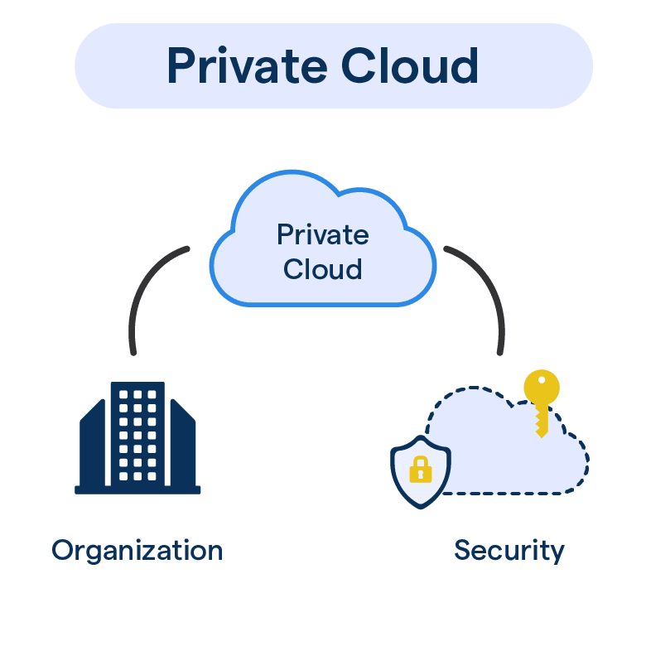
PRIVATE CLOUD – HIGH SECURITY & FULL CONTROL
  Cloud environment is used exclusively by one organization.
  Can be hosted on-site or by a third-party vendor.
  Provides maximum security, privacy, and customization.
  Suitable for industries handling sensitive data (banking, defense, healthcare).
  Examples:
  A bank’s internal cloud data center
  Government’s NIC private cloud
  Healthcare systems storing patient data securely

Slide 5
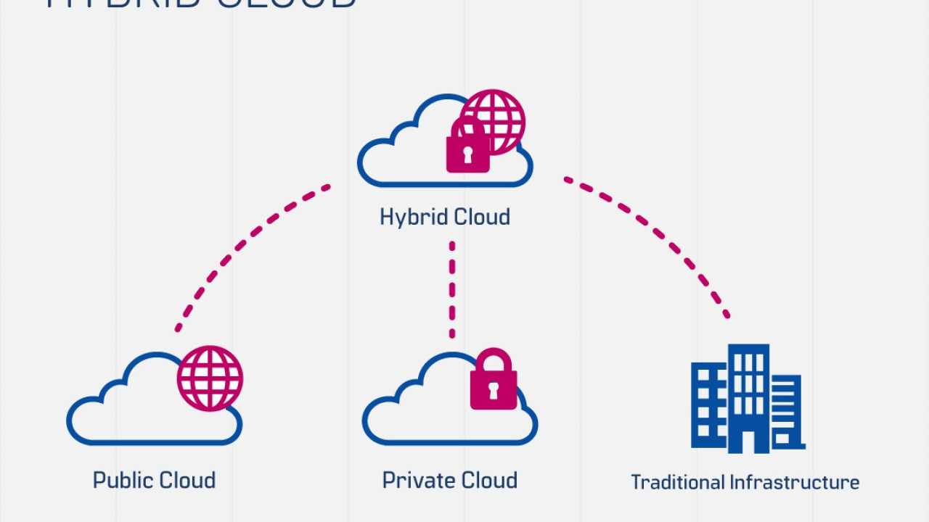
HYBRID CLOUD – MIX OF PUBLIC + PRIVATE
  Combines private cloud for sensitive data and public cloud for general tasks.
  Allows data and applications to move between environments.
  Provides a balance of security, cost-efficiency, and performance.
  Used by organizations that need to scale without compromising sensitive data.
  Examples:
  Hospital storing patient medical records privately but using public cloud for appointment systems
  E-commerce companies keeping payment data private while using AWS for heavy traffic

Slide 6
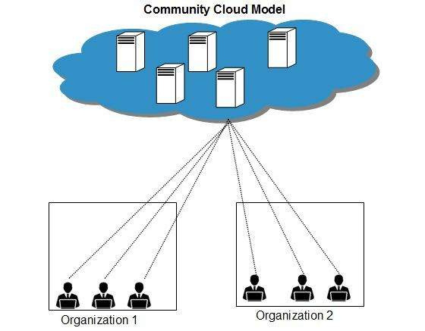
COMMUNITY CLOUD – SHARED BY SIMILAR USERS
  Shared infrastructure for organizations with common goals or regulations.
  Cost, security, and resources are shared.
  Best for groups that need collaboration and similar compliance rules.
  Examples:
  Group of universities sharing a research cloud
  Healthcare organizations jointly using a cloud for medical research
  Government departments sharing a cloud for public welfare data

Slide 7
THANK YOU

